Slide 1
Introduction to Arduino
Measuring distance with Arduino

Slide 2

Workshop Aim
By the end of this workshop you will have achieved the following
Learnt some basic programming in Arduino
Tested some different soils for moisture content
Setup sensors to help you monitor the wellbeing of your plant
Notes:
https://www.tiagoespinha.net/2014/05/project-how-to-easily-monitor-your-plants-soil-humidity/

Slide 3
Arduino Intro
The Arduino is a tool known as a microcontroller; it is basically a device that you can use externally from, or in conjunction with a computer to sense and control physical inputs and outputs. With a focus on enhancing interactivity, the Arduino can be used as a standalone device, or interfaced with your computer to control other software packages.
You can buy Arduinos pre-assembled, there are also many variations of the Arduino, known as clones, that you can assemble yourself. To support the physical side of the Arduino, there is a free and open source software that allows you to easily program the microcontroller.

Slide 4
Welcome to Arduino
Below is a the Arduino board, this is the physical hardware of the Arduino.
You can get a few different types of Arduino boards, but today we will be working with the Adafruit Feather!

Slide 5
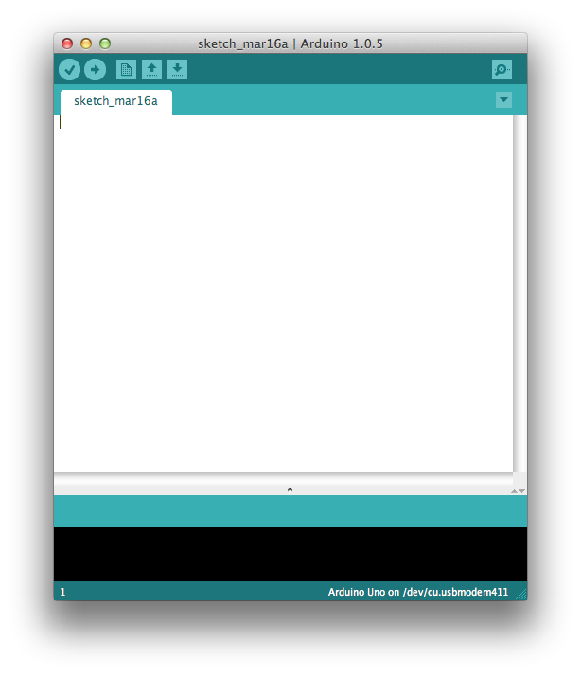
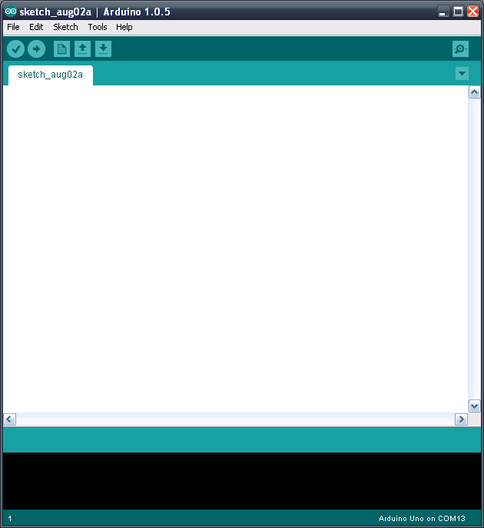
Welcome to Arduino
This is the Arduino Integrated Development Environment, or IDE this is the software side Arduino. You’ll be writing your programs in here, these are known as sketches.
If you’ve already installed the Arduino IDE – open it up.
If you need a hand installing then give me a shout!
The Arduino IDE 1.0.5 -> OSX (L) and Windows (R)
(Source: http://panasonic.mironto.sk/wp-content/uploads/arduino_ide.png)

Slide 6
Useful links
Arduino Reference: Look up code in the Language Reference guide
Tutorials: Explore Arduino more using their Learning page.
Forum: Ask for a hand in Arduino’s help forum

Slide 7
Workshop Tools
We have a number of different sensors for you to test out.
Please select one and try and get it working following the instructions in this document.
If you need any help, please raise your hand!
Notes:
Has everybody got everything?

Slide 8
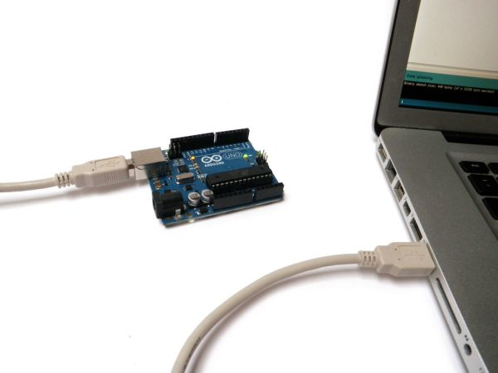
Connecting the Arduino
Plug the Arduino into your laptop using the USB Cable.
This allows your laptop to communicate with your Arduino using serial data and vice versa. Make sure it’s plugged in when you’re uploading code to it.
Now go into the Arduino IDE on you laptop to select the right board by going:
Tools > Board > Adafruit Feather M0
You then need to select the port
Tools > Port XXX
Connecting the Arduino to your Laptop
(Source:http://duino4projects.com/introduction-to-arduino/)
Notes:
Has everybody got everything?

Slide 9
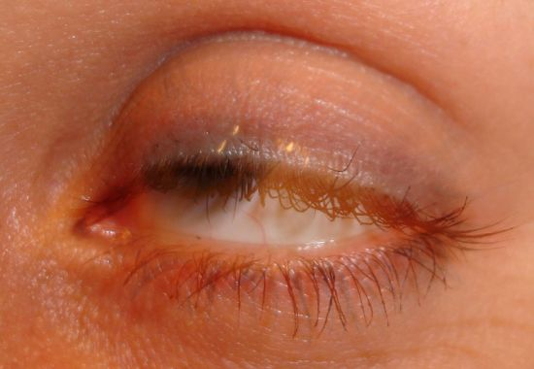
BLINK ;)
So the first thing we are going to do is make the Arduino blink, more specifically an LED on the Arduino blink.
We’re going to take a bit of time going over this code as it’s full of useful examples to get you familiar with programming in the Arduino IDE.
(Source: http://www.tumyeto.com/images/uploaded/---blink-eye_opt.jpg)

Slide 10
BLINK ;)
Copy and paste the following code into a new sketch in the Arduino IDE:
const int ledPin = 13; // LED is on pin 13. Won’t change so set as constant
// put your setup code here, to run once:
void setup() {
pinMode(ledPin, OUTPUT); // set pin direction
}
// put your main code here, to run repeatedly:
void loop() {
digitalWrite(ledPin, HIGH); // turn LED on
delay(1000); // delay 1000ms
digitalWrite(ledPin, LOW); // turn LED off
delay(1000); // delay 1000ms
}
Notes:
Talk through the code

Slide 11
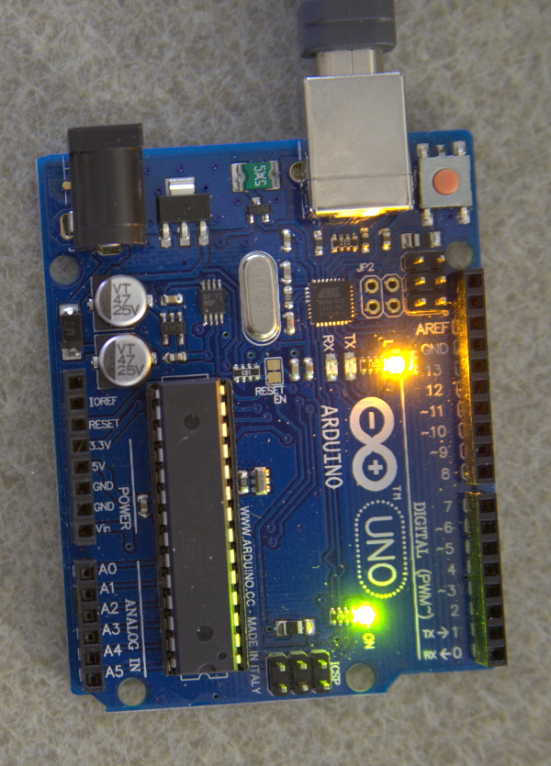
BLINK ;)
Then click
Pressing this button tells the Arduino IDE to compile you code, which basically means check it for any errors and upload it to the Arduino.
If everything has worked successfully, the LED circled in the picture below should be blinking ON and OFF every second.
Blinking Arduino
(Source: http://www.benbarbour.com/content/arduino/Tutorial1.1/just_arduino_led_high.png)

Slide 12
BLINK ;)
The value you put in the delay is in milliseconds. So putting a value of 1000 in makes it blink on and off ever second, 500 is half a second etc. etc.
Experiment changing the delay values to create different blinking effects, you can even add more delays in if you fancy!
Try changing the OFF/LOW value till you can’t see the LED turning off.
Important things to note:
Every line of code ends with a semicolon “;” to separate different statements.
“//” is used to make comments in the code that the machine ignores. This is helpful when trying to remember what each bit of your code does.

Slide 13
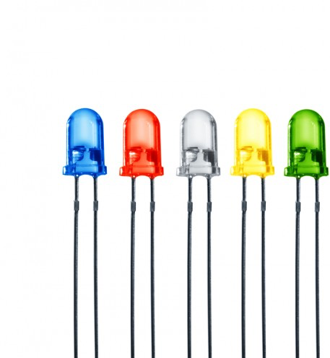
LED:: INTRO
LED stands for light-emitting diode.
In the simplest terms, an LED is a semiconductor device that emits light when an electric current is passed through it.
Light is produced when the particles that carry the current (known as electrons and holes) combine together within the semiconductor material.

Slide 14
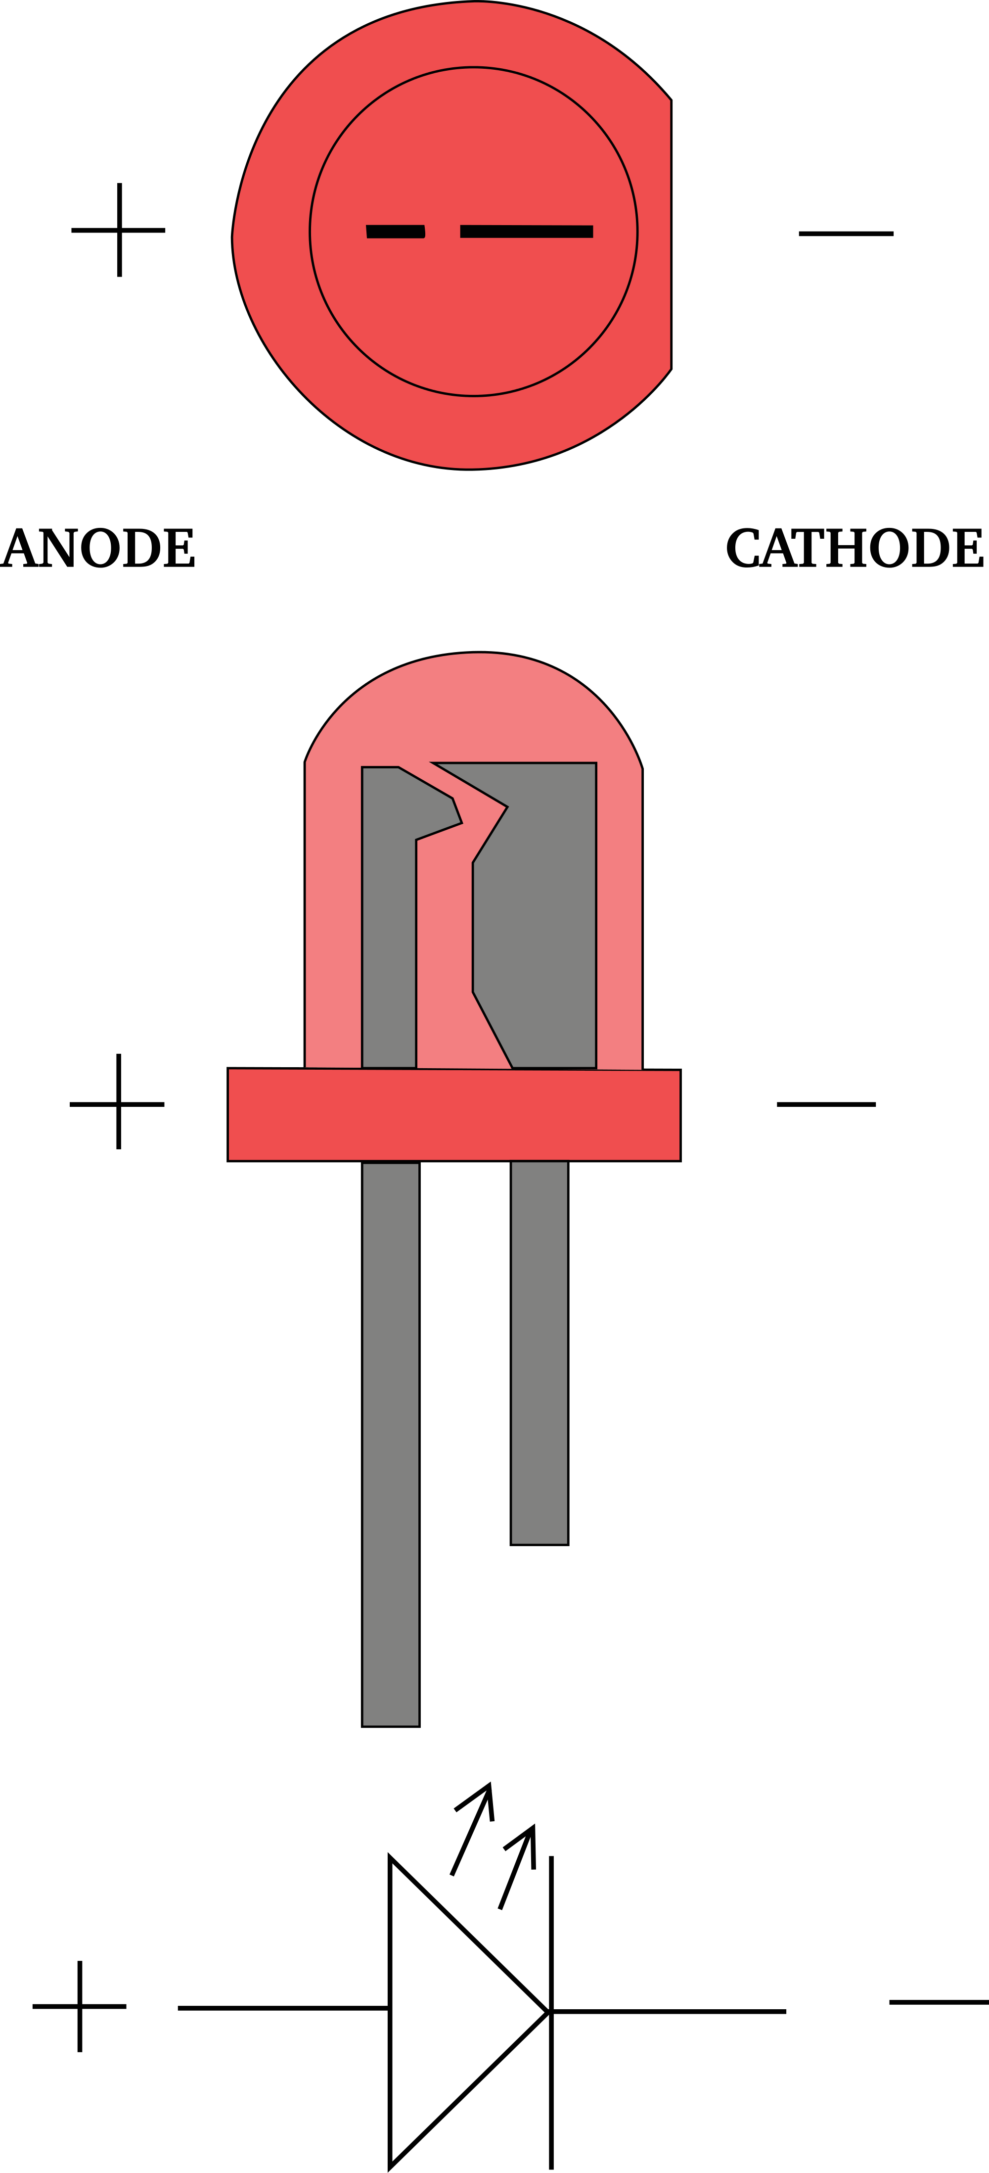
LED:: ANODE + CATHODE
Diodes only allow current to flow in one direction, and they’re always polarized. A diode has two terminals. The positive side is called the anode, and the negative one is called the cathode.
There are a handful of identifiers for finding the positive and negative pins on an LED. You can try to find the longer leg, which should indicate the positive, anode pin.
Or, if someone’s trimmed the legs, try finding the flat edge on the LED’s outer casing. The pin nearest the flat edge will be the negative, cathode pin.

Slide 15

CONNECTING PARTS TO BREADBOARD
An electronics breadboard (as opposed to the type on which sandwiches are made) is actually referring to a solderless breadboard. These are great units for making temporary circuits and prototyping, and they require absolutely no soldering.
Prototyping is the process of testing out an idea by creating a preliminary model from which other forms are developed or copied, and it is one of the most common uses for breadboards. If you aren’t sure how a circuit will react under a given set of parameters, it’s best to build a prototype and test it out.
Notes:
https://learn.sparkfun.com/tutorials/how-to-use-a-breadboard

Slide 16
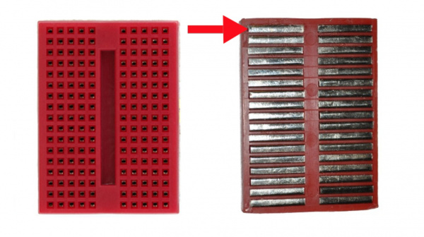
CONNECTING PARTS TO BREADBOARD
Here we have a breadboard where the adhesive backing has been removed. You can see lots of horizontal rows of metal strips on the bottom of the breadboard.
The tops of the metal rows have little clips that hide under the plastic holes. These clips allow you to stick a wire or the leg of a component into the exposed holes on a breadboard, which then hold it in place.
Notes:
https://learn.sparkfun.com/tutorials/how-to-use-a-breadboard

Slide 17
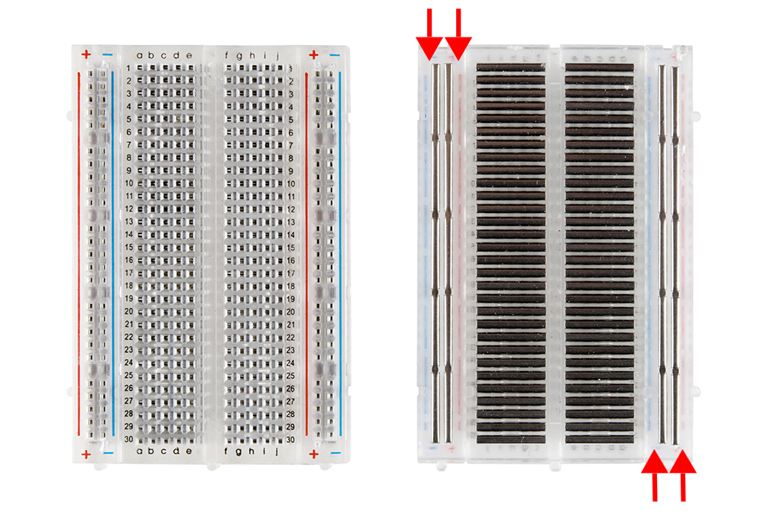
CONNECTING PARTS TO BREADBOARD
Aside from horizontal rows, breadboards usually have what are called power rails that run vertically along the sides.
These power rails are metal strips that are identical to the ones that run horizontally, except they are, typically*, all connected. When building a circuit, you tend to need power in lots of different places. The power rails give you lots of easy access to power wherever you need it in your circuit. Usually they will be labelled with a ‘+’ and a ‘-’ and have a red and blue/black stripe, to indicate the positive and negative side.
Notes:
https://learn.sparkfun.com/tutorials/how-to-use-a-breadboard

Slide 18
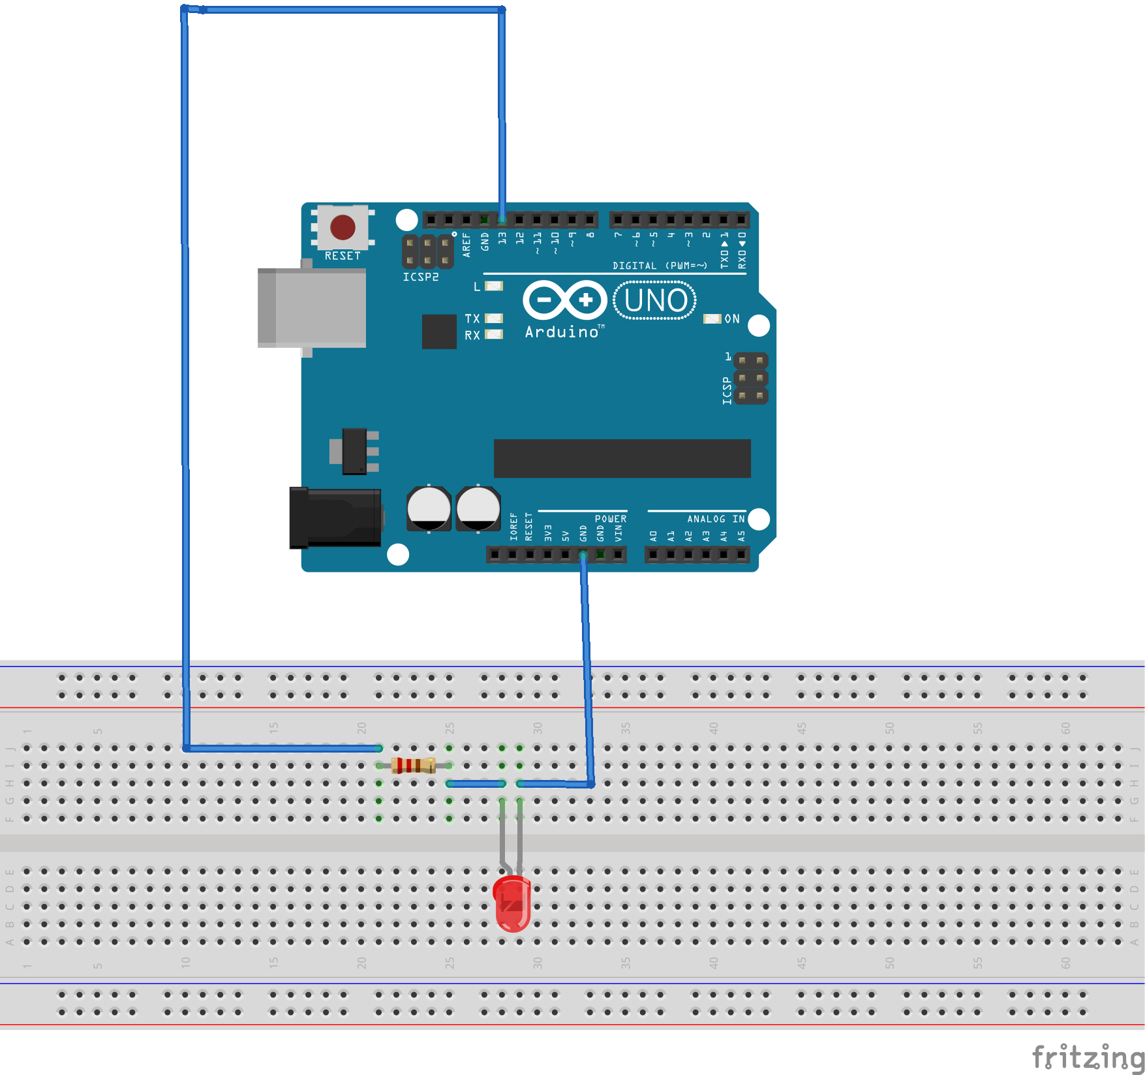
LED :: BUILDING THE CIRCUIT
Assemble your board as shown below

Slide 19
Adding Libraries
The Arduino IDE can be extended through the use of libraries. They provide extra functionality for use in sketches and can be contributed by anyone in the community.
Libraries are a collection of code that makes it easy for you to connect to a sensor, display, module, etc. For example, the built-in LiquidCrystal library makes it easy to talk to character LCD displays.
You can see some different libraries here.
Notes:
There are 2 gnd pins on the Arduino

Slide 20
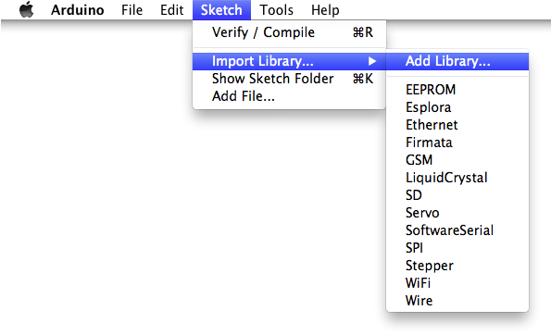
Adding Libraries
Once the Library is downloaded, you need to install it in Arduino.
First unzip the file by clicking on it.
In the Arduino IDE navigate to Sketch > Import Library. At the top of the drop down list, select the option to "Add Library''.
Notes:
There are 2 gnd pins on the Arduino

Slide 21
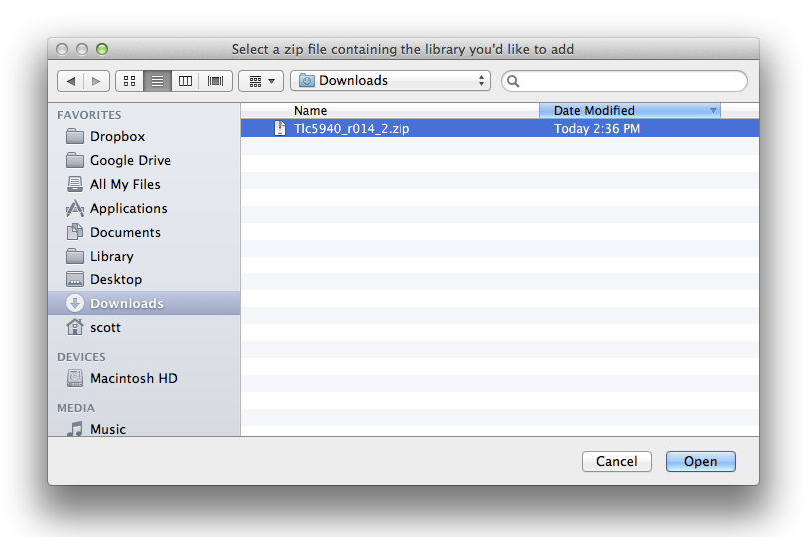
Adding Libraries
You will be prompted to select the Library you would like to add. This will be in the downloads folder of your computer. Navigate to the files location and open it.
Notes:
There are 2 gnd pins on the Arduino

Slide 22
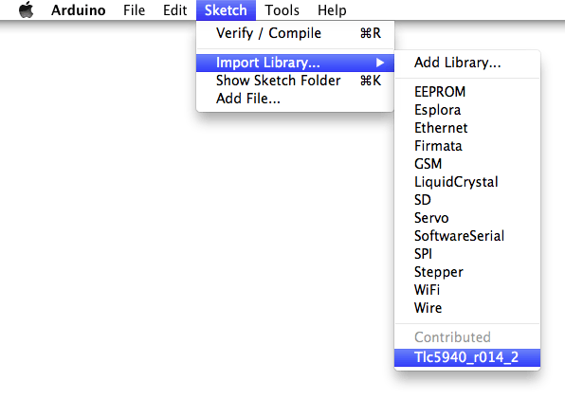
Adding Libraries
Return to the Sketch > Import Library menu, you should now see the New Tone library at the bottom of the drop-down menu.
Notes:
There are 2 gnd pins on the Arduino

Slide 23
Measuring light
Connect your ALS chip to your Arduino Feather as follows
ALS-PT19 | Feather
+ | 3V
A0 | 12
- | Gnd
Code for this chip is found in here.
Notes:
https://learn.adafruit.com/photocells/measuring-light

Slide 24
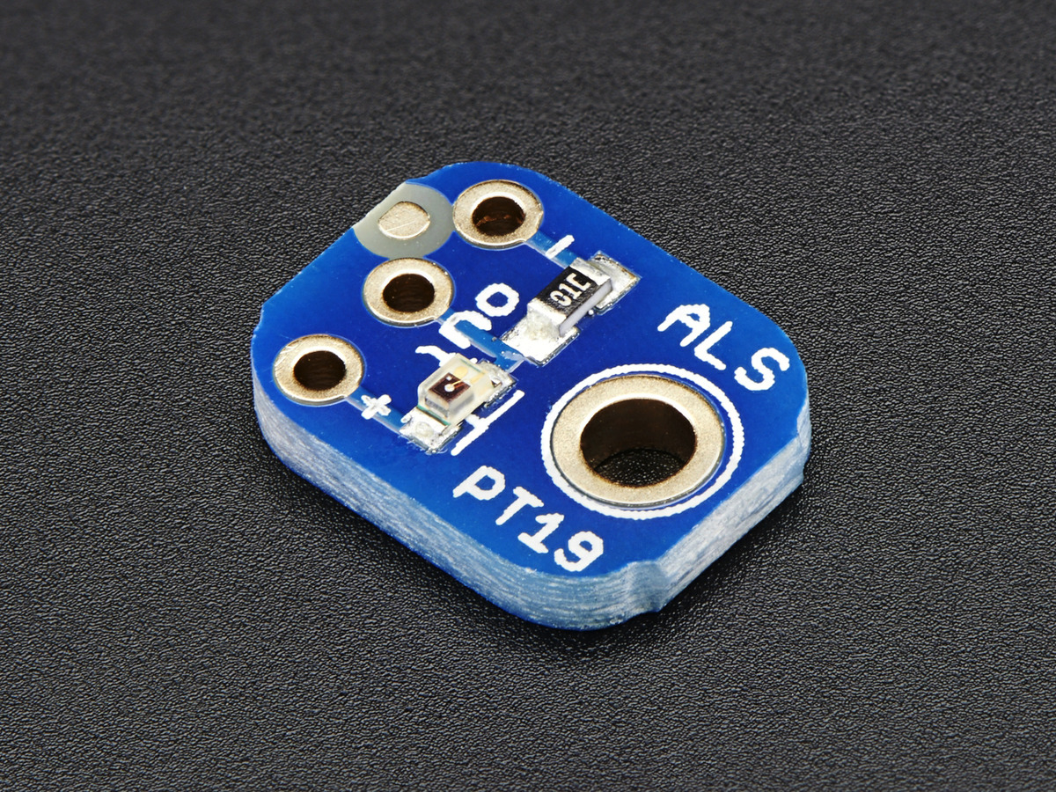
Measuring light
Photocells are sensors that allow you to detect light. They are small, inexpensive, low-power, easy to use and don't wear out. For that reason they often appear in toys, gadgets and appliances. They are often referred to as CdS cells (they are made of Cadmium-Sulfide), light-dependent resistors (LDR), and photoresistors.
More info here
You have one of these in your phone—what does it do?

Slide 25
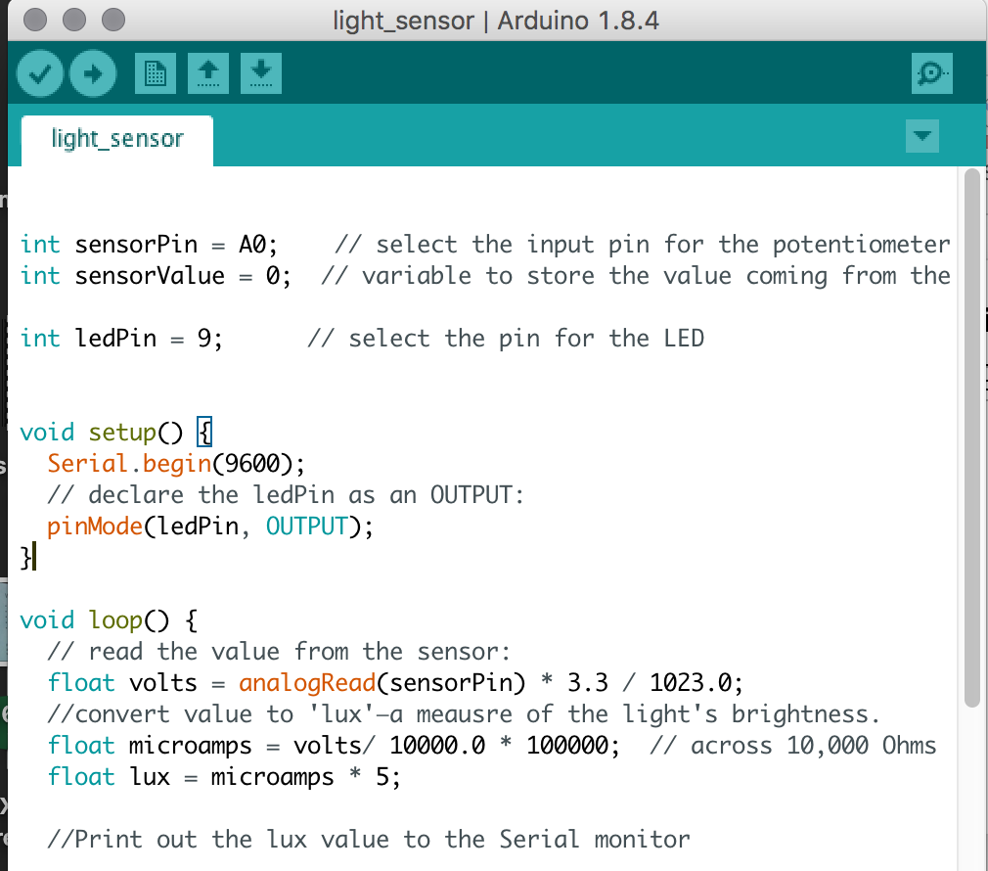
Measuring light
Open the file light_sensor.ino

Slide 26
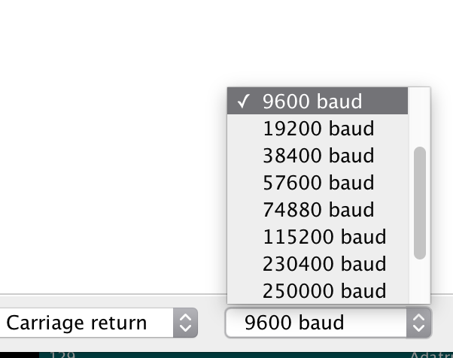
Measuring light
Hit the compile button and upload the code to your Arduino.
Your code has uploaded, and you are flapping your hand back and forth in front of the light sensor. But how do you know that it is working?
The lines at the very bottom of the code print the values measure by the sensor to the Serial Monitor.
Press this button in the Arduino IDE to open the serial monitor.
If weird symbols are appearing, check that the baud rate is 9600 in the dropdown menu. Don’t worry, you don’t need to understand
this for now.
Notes:
I won’t go into detail about this today

Slide 27
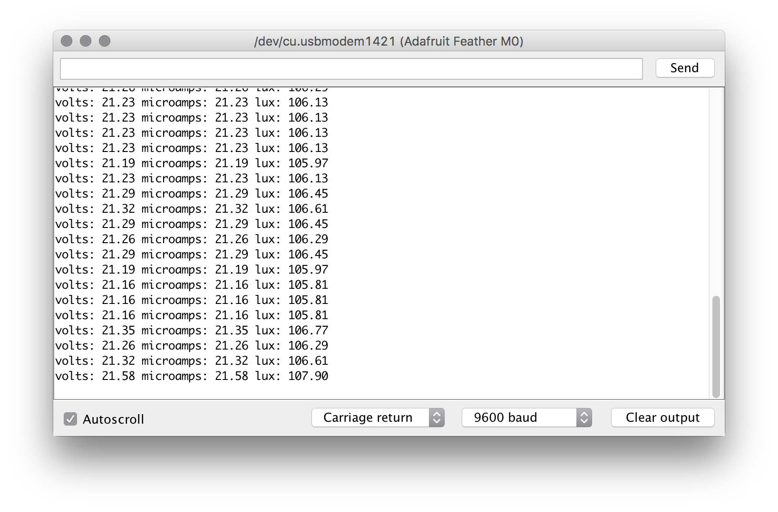
Measuring light
If everything has gone smoothly, you should see values appear in the window like so:
Try making it lighter and darker, what do the values do?
Notes:
I won’t go into detail about this today

Slide 28
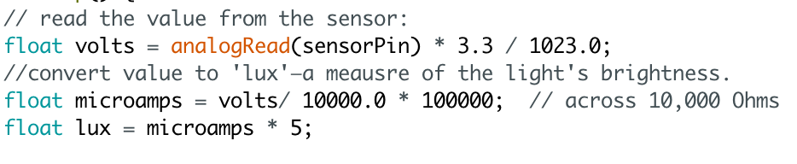
Measuring light
The algorithm below converts the raw data collected from the Arduino into a ‘lux’ value—which is a the SI unit of illuminance, equal to one lumen per square metre.
This first line calculates a value for the voltage being read into the microcontroller.
This is then converted into micro amps using the equation
Amps = Voltage * Resistance.
Try making it lighter and darker, what do the values do?
Notes:
I won’t go into detail about this today

Slide 29
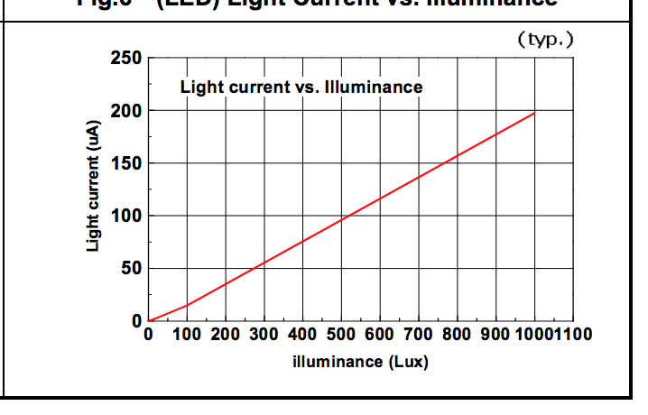
Measuring light
From this graph in the sensor’s datasheet I see that for around 100uA the luminance is 500 lux. So I calculate the luminance through multiplying the microamps by 5.
How accurate is my algorithm? To what extent do you trust it?
Test this algorithm. Is it working?
Notes:
I won’t go into detail about this today

Slide 30
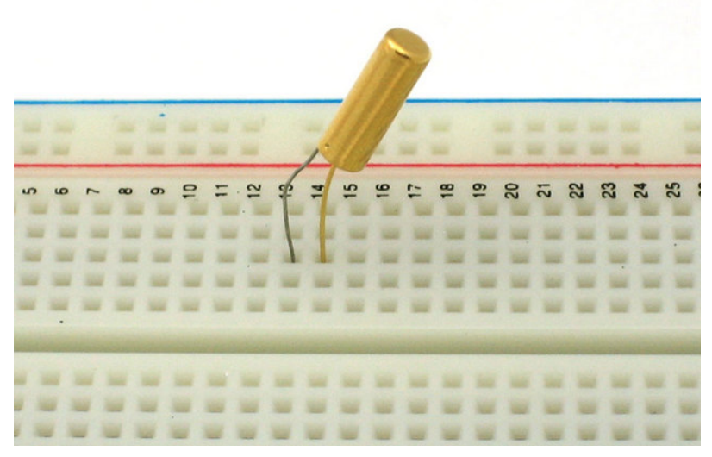
Measuring tilt
Got to this website for instructions on how to hook up your microcontroller and tilt sensor.
Notes:
https://cdn-learn.adafruit.com/downloads/pdf/tilt-sensor.pdf

Slide 31
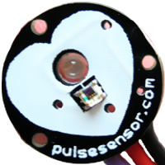
Measuring heart rate
Got to this website for instructions on how to hook up your microcontroller and pulse sensor.
Notes:
https://github.com/WorldFamousElectronics/PulseSensorStarterProject

Slide 32
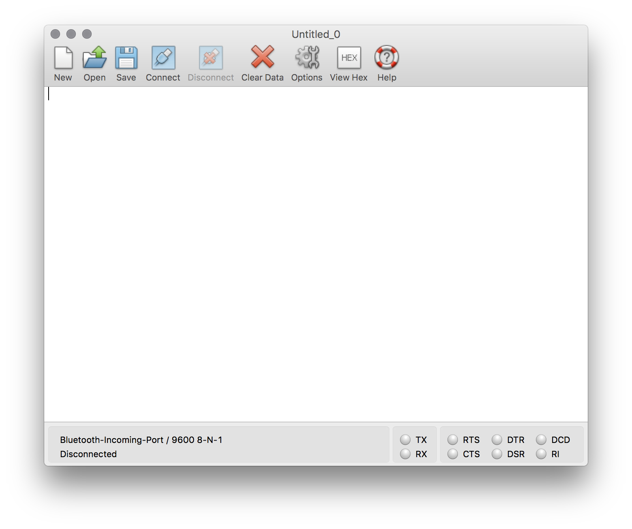
Storing data
We can store the data we capture using our Arduino as a .csv file (remember Outwit hub?). Follow these instructions to capture your data to a file.
Remember, you need to select the port that your Arduino is connected to!
How did you set the baud rate?
Notes:
https://learn.sparkfun.com/tutorials/terminal-basics/coolterm-windows-mac-linux

